Slide 1

Bully Box:
Stop Bully. Report it Fully.
Prakruti Bhavsar 21104067
Payal Gupta 21104057
Nimisha Idekar 21104014
Prof. Shweta Mahajan

Slide 2
Contents
Introduction
Objectives
Scope
Features / Functionality
Project Outcomes
Technology Stack
Block Diagram/ Flow

Slide 3
1. Introduction
Bully Box is an application / a tool where reports of bullying and ragging are filed, and higher authorities take notice and take appropriate action.
Problem Identified :
    There is no online platform to register complaints against specifically bully in an organization.
Solution Proposed :
    A platform where student can file concerns; in addition, we offer remedies to help student‘s mental health.

Slide 4
2. Objectives
To provide safe and secure environment for student to register complaints.
To minimize bullies and facilitate early resolution.
To make complaints easier to coordinate, monitor, track and resolve.
To alleviate student’s mental health.

Slide 5
3. Scope
Can encourage students to face their fears and speak out against bullies.
Can reduce the bullies in the institutions.
Can help students and institution to keep track of the complaints.
Can alleviate student’s mental health.
Can be used anytime and anywhere.

Slide 6
4. Feature /Functionality
1. Registration of complaint:
A complaint form is supplied to the user. All of the parameters that an administrator needs to know are on the form. The complaint will be listed on the admin's sticky note in addition to the user who filed it after submission.
2. Acknowledgment on complaint:
Once a complaint is received from student, an acknowledgement is send from admin to student through inbox.
3. Complaint status Tracker:
Students will receive a complaint ID for each registered complaint. They can monitor the progress of their concerns by using this complaint ID status is updated by admin and student can access status of the complaint

Slide 7
4.Punishment declaration:
The user may also be informed of punishment by the admin. Similar to how a complaint is registered, a punishment is similarly registered. Only admins and the recipient will be able to see it.
5.Articles:
Articles on improving mental health as well as on bullying prevention.
6.Counselling appointment:
Student can request for counselling session. The schedule for counselling will be send in student’s inbox. It can provide them with supports, guidance, and tools to deal with the situations.
7. Communication between student and admin is similar to mail system:
The admin handling the complaint will have the facility to communicate with the student via emails through the system. The services are given through the system are through email. The proposed system is automated process of sending and receiving.

Slide 8
5. Outcome of Project
Student can register complaint.
Student may receive feedback on the registered complaint.
Student can track the status of register complaint.
Student can request for counselling session.
Student can read articles on improving mental health as well as articles on bullying prevention
Student can enhance his/her mental health.
Admin can view and respond to the compliant.
Admin can update the status of complaint
Admin can register the student.

Slide 9
6. Technology Stack
1.TKINTER :
TKINTER is used to create graphical Student interface (GUIs) and is included in all standard python distribution.
MYSQL :
MYSQL was used to create the database for the website.

Slide 10
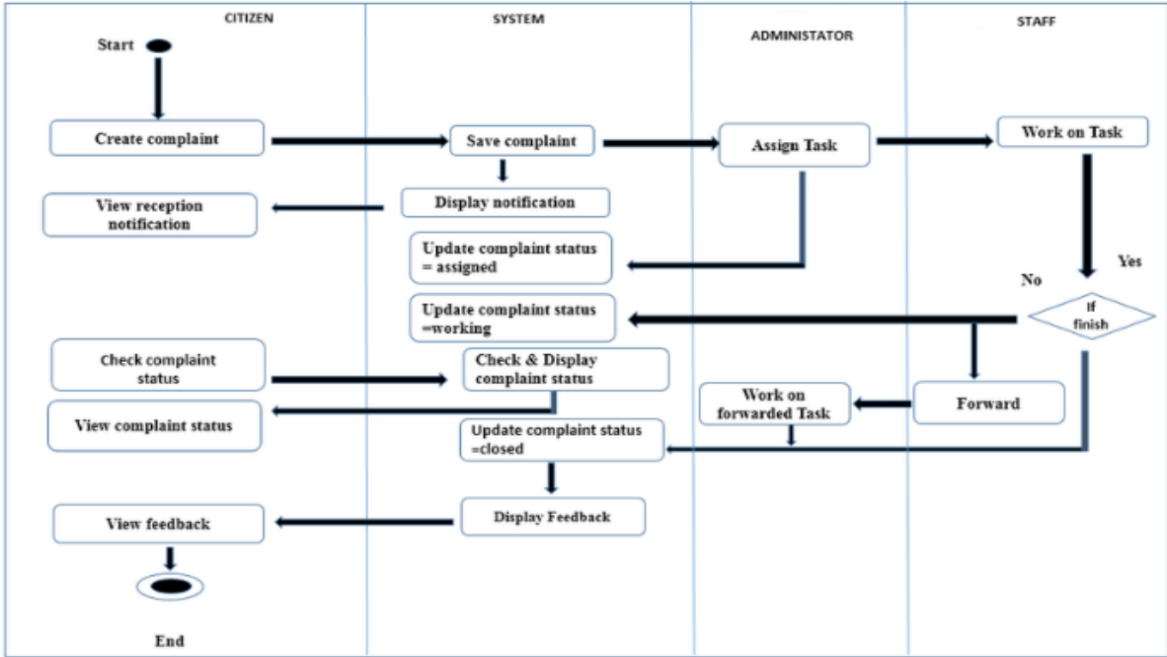
7. Block Diagram/ Flow Chart
STUDENT
SYSTEM
ADMINSTRATOR
STAFF
Start
Create complaint
Save Complaint
Assign Task
Work on Task
View Acknowledgement
Display Complaint
Update Complaint Status = Assigned
Update Complaint Status = Under Investigation
Check complaint status
Check and Display complaint status
Work on Forwarded Task
Forward
View Complaint status
Update Complaint Status = Resolved
View Feedback
Display Feedback
End

Slide 11
Thank You...!!

